Slide 1
Lecture 4
Physiology 210

Slide 2
TAs: marissa.aycan@mail.mcgill.ca Michael.chen5@mail.mcgill.ca
Tutorials:
January 24th: 5h30 to 6h30 pm mcmed 522 February 2nd: 5h30 to 6h30 pm mcmed 522

Slide 3
H. Measuring Pulmonary Blood Flow (Q) Using Fick's principle
.
.
O2 consumption per minute (VO2) is equal to the O2 taken up by the blood in the lungs in one minute. The [O2] in the blood entering the lungs is CVO2 and
that leaving is CaO2. It then follows that:
.
.
VO2= Q(CaO2 - CVO2)
.
.
or
Q= VO2/ (CaO2 – CVO2)
w. here:
VO2: measured by comparing [O2] in the expired gas collected in a large spirometer and [O2] in inspired gas;
CaO2: measured from an artery;
CVO2: measured via a catheter from the pulmonary artery.

Slide 4
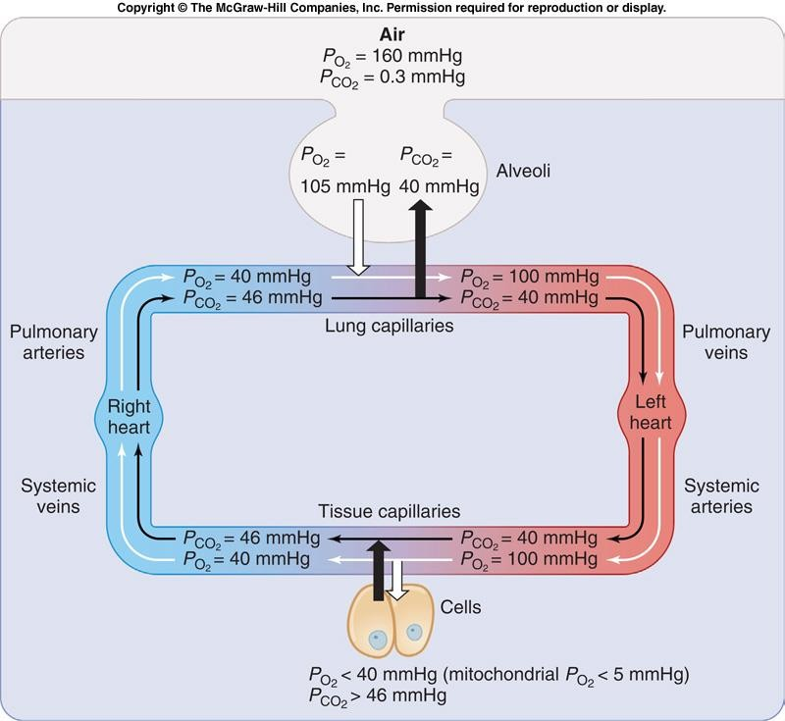
.

Slide 5
V TRANSPORT OF O2 and CO2
A. O2 Physically Dissolved in Plasma
•The amount of dissolved gas carried by the blood is directly proportional to the partial pressure of the gas (Henry’s Law).
•Because O2 is relatively insoluble in H2O, the amount of O2 dissolved in blood is very small, and linearly proportional to PO2.
•Example: In 100 ml of plasma, there is 0.3 ml of O2 at a PO2 of 100
mm Hg.
.
•O2 consumption (VO2) by the body cells is about 300 ml O2/min. Therefore, if
O2 were only found in plasma, the tissue demand for O2 would never be met.

Slide 6
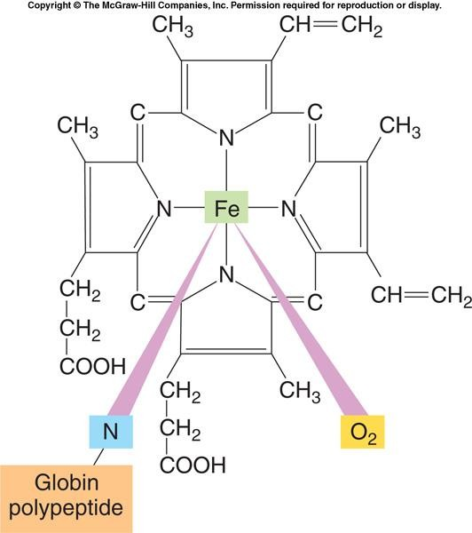
B. O2 Bound to Hemoglobin
Hemoglobin (Hb) is found in red blood cells, and permits whole blood to take up to 65 times as much O2 as plasma, at a PO2 of 100 mm Hg. Each molecule of Hb consists of 4 subunits bound together. Each subunit is made up of a heme joined to a globin. Heme contains an Fe⁺⁺ ion that can bind to 1 molecule of O2.

Slide 7
O2 Bound to Hemoglobin
•Hb is essential for the transport of O2 by blood because it combines rapidly and reversibly with O2:
Hb + O2 ↔ HbO2
•At PO2 of 100 mm Hg, the total amount of O2 dissolved in the blood is 0.3 vol.%, and the total amount of O2 bound to Hb is 19.5 vol. %. This means that the total amount of O2 in arterial blood is about 20 vol. %.
(O2 bound to Hb does not contribute to the PO2 of the blood. Only molecules dissolved in the blood plasma are responsible for PO2. However, the PO2 of the plasma does determine the amount of O2 that combines with Hb).

Slide 8
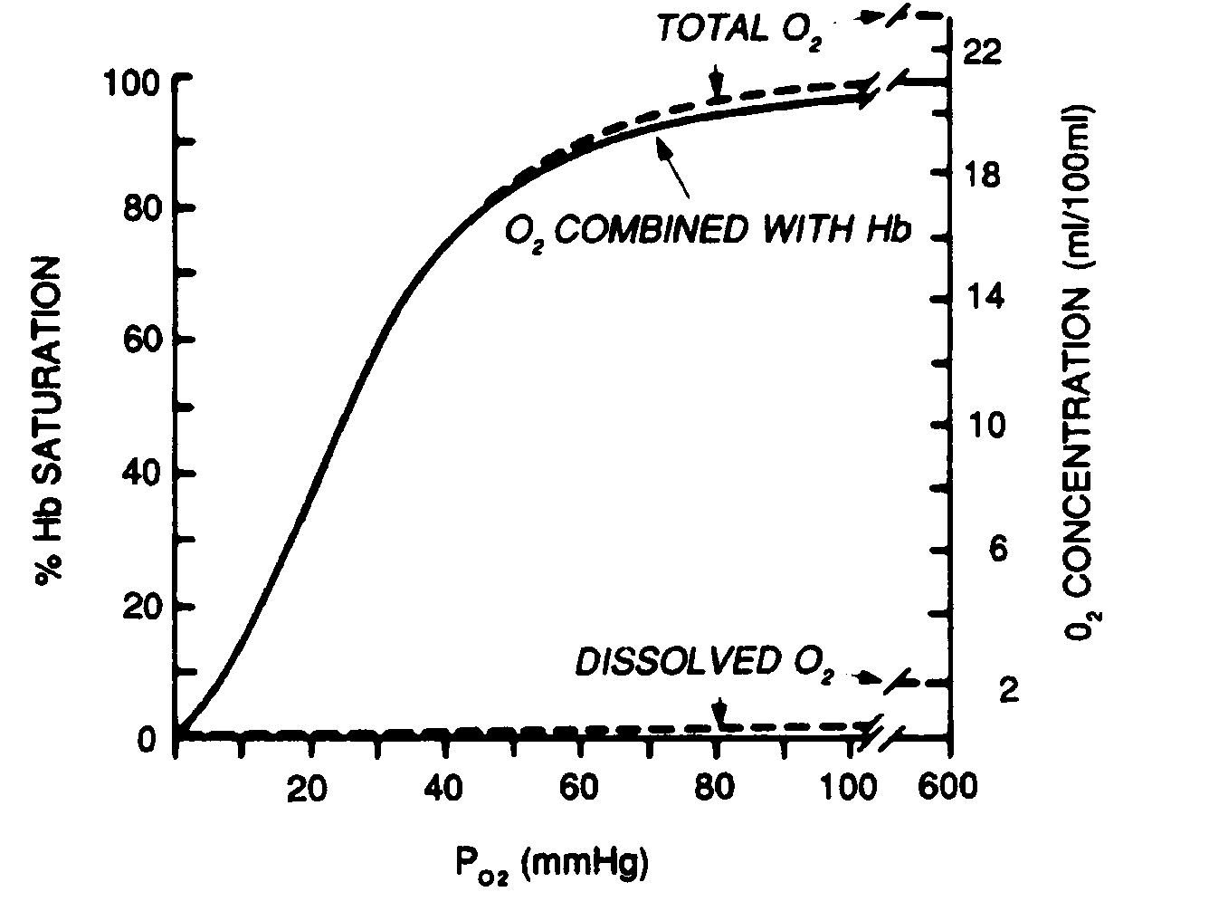
C. The O2 dissociation curve
•The HbO2 dissociation curve determines the amount of O2 carried by Hb for a given partial pressure of O2.
•The curve is flat at high values of PO2 and steep at low values of PO2.

Slide 9

The O2 dissociation curve (Cont’ed)
•Hb provides an automatic mechanism that matches tissue O2 supply to tissue O2 need.
•At low values of PO2, as seen in the peripheral tissues, a small drop in PO2 unloads
the O2 from Hb to the tissue.
Example: A drop in PO2 from 40 to 20 mmHg results in a decrease in %HbO2 from about 75% to 35%; a drop in PO2 from 100 to 80 mmHg results in a decrease of less than 3 %).

Slide 10
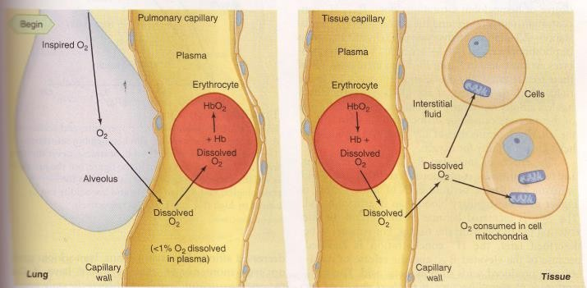
Copyrigth© The McGraw-Hill Companies, Inc. Permission requires to reproduce or display.

Slide 11
Shape of Hemoglobin dissociation curve
The quaternary structure of Hb determines its affinity for O2;
The combination of the first heme of Hb with O2 increases the affinity of
the second heme for O2, etc. (cooperative binding).
Myoglobin, found in skeletal muscle, resembles Hb but binds only one O2 molecule. The O2-myoglobin curve is hyperbolic in shape. It follows that myoglobin will release its O2 only at very low PO2.

Slide 12
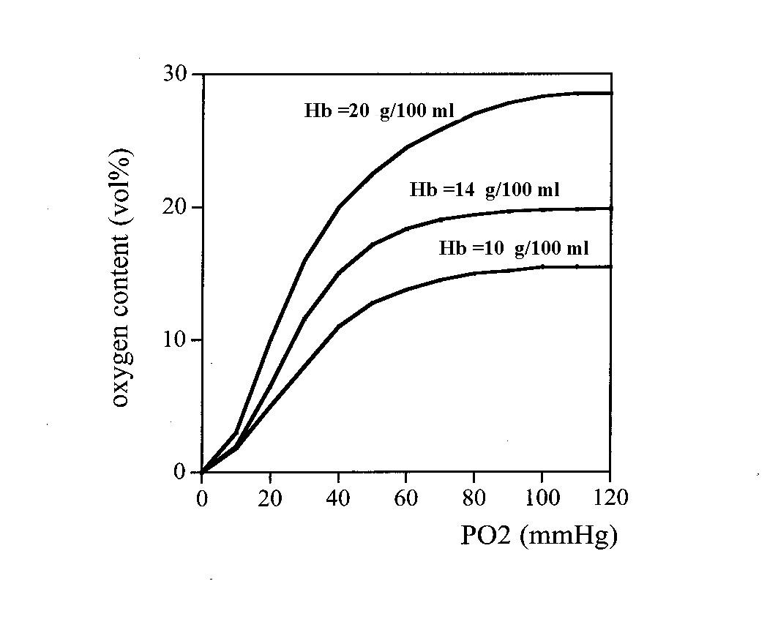
The O2 dissociation curve (Cont’ed)
The total amount of O2 in the blood depends mostly on Hb concentration. Under conditions of decreased Hb concentration (anaemia) even when O2 saturation is 97.5%, less O2 can be carried in the blood by Hb.

Slide 13
D. The Bohr Effect
•The Bohr Effect is the shift of the HbO2 dissociation curve to the right when blood CO2 or temperature increases, or blood pH decreases.
•Example: When we exercise, we increase our CO2 and acid production and generate heat. The curve shifting to the right means that for a given drop in PO2, an additional amount of O2 is released from Hb to the working tissues.
(Note that these factors have little effect on the total amount of O2 combined with Hb above
80 mm Hg).

Slide 14
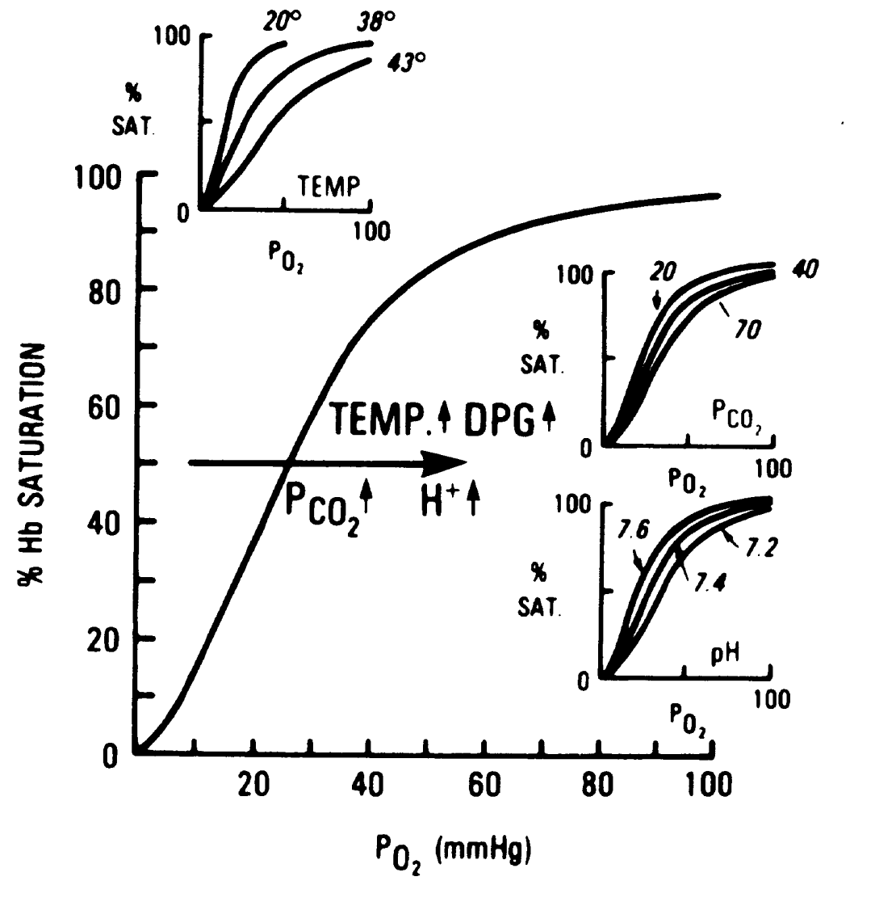
The Bohr Effect
Reproduced from West: Respiratory Physiology- the essentials).

Slide 15
E. Carbon monoxide poisoning
CO has an extremely high affinity for the O2 binding sites in hemoglobin (210- fold).
Therefore it reduces the amount of O2 bound to hemoglobin.
It also shifts the O2-hemoglobin curve to the left, thus decreasing the unloading of O2 to the tissue.
In CO poisoning, there is little stimulation to increase ventilation because PaO2 remains normal.

Slide 16
F. Transport of CO2
CO2 is the primary product of the oxidative processes taking place in the body cells, and it is removed from the tissues by the blood.
CO2 is carried in three forms in the blood:
Physically dissolved in blood (10%)
Combined with Hb to form HbCO2 (11%)
(CO2 combines with the globin portion not heme.)
3) As bicarbonate (79%)
(CO2 combines with H2O to produce carbonic acid (H2CO3). This reaction is in red blood cells by carbonic anhydrase (CA), according to:
CA
CO2 + H2O → H2CO3 (1)
H2CO3 then ionizes into bicarbonate (HCO3⁻) and H⁺ ions as:
H2CO3 → HCO3⁻ + H⁺ (2)
aided

Slide 17
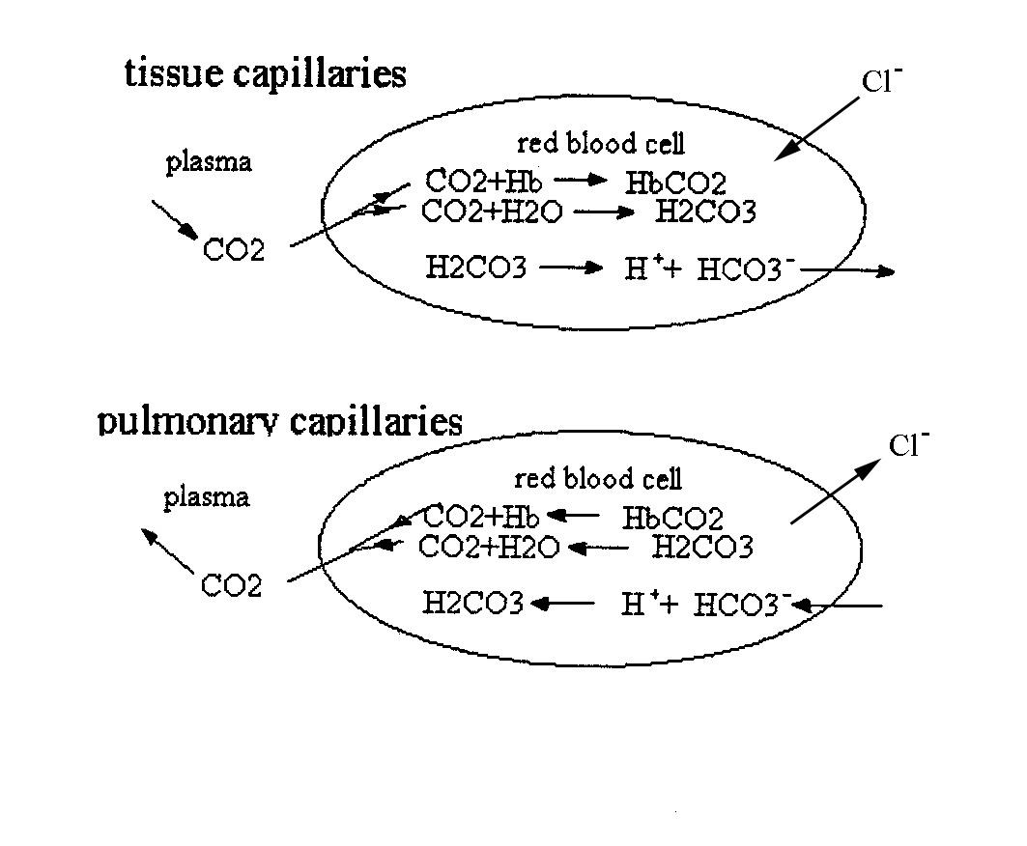
Transport of CO2

Slide 18
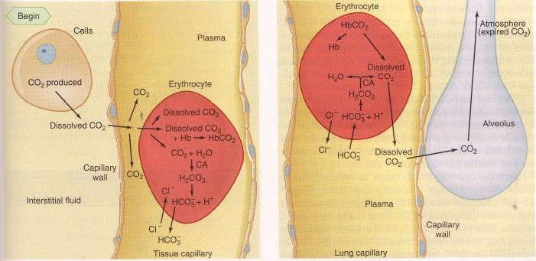
Copyrigth© The McGraw-Hill Companies, Inc. Permission requires to reproduce or display.

Slide 19
Transport of CO2
•All these reactions are reversible, so they can proceed in either direction, depending upon the prevailing conditions.
•If CO2 production increases, the production of HbCO2, HCO3⁻, and H⁺
increases, as in equations 1 and 2.
•Lowering of blood PCO2 results in HCO3⁻ going to H2CO3 and further into CO2 and H2O, and HbCO2 generating Hb and CO2. This situation occurs when venous blood flows through the lung capillaries, as in equations 3 and 4:
CA
H⁺ + HCO3⁻ → H2CO3 → H2O + CO2, (3)
HbCO2 → Hb + CO2 (4)
Because the blood PCO2 is higher than alveolar PCO2, a net diffusion from the blood into the alveoli lowers the blood PCO2. Normally, as fast as CO2 is generated from HCO3⁻ and HbCO2, it diffuses into the alveoli.

Slide 20
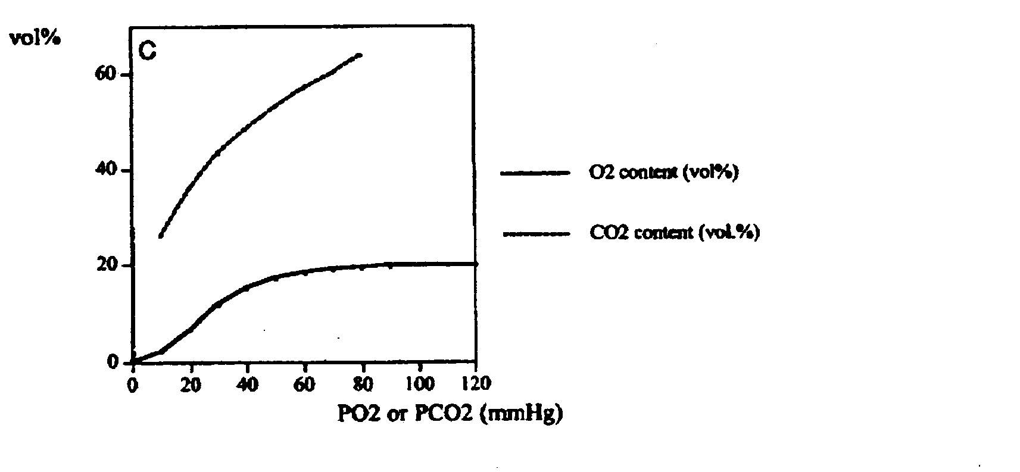

Slide 21
G. The Haldane Effect
•In the tissue capillaries, Hb free of O2 may combine with H⁺, in the reaction:
H⁺ + HbO2 ⇌ HHb + O2
•This occurs because reduced Hb is less acidic than HbO2. Hb acts as a buffer.
•So, reduced Hb in the tissue capillaries helps with the blood loading of CO2, by pushing equations 1 and 2 to the right. This is known as the Haldane effect.
∴ For a given PCO2, more CO2 is carried in deoxygenated blood than in oxygenated blood.

Slide 22
Transport of CO2
CO2 + H2O → H2CO3 (1)
H2CO3 then ionizes into bicarbonate (HCO3⁻) and H⁺ ions as:
H2CO3 → HCO3⁻ + H⁺ (2)

Slide 23
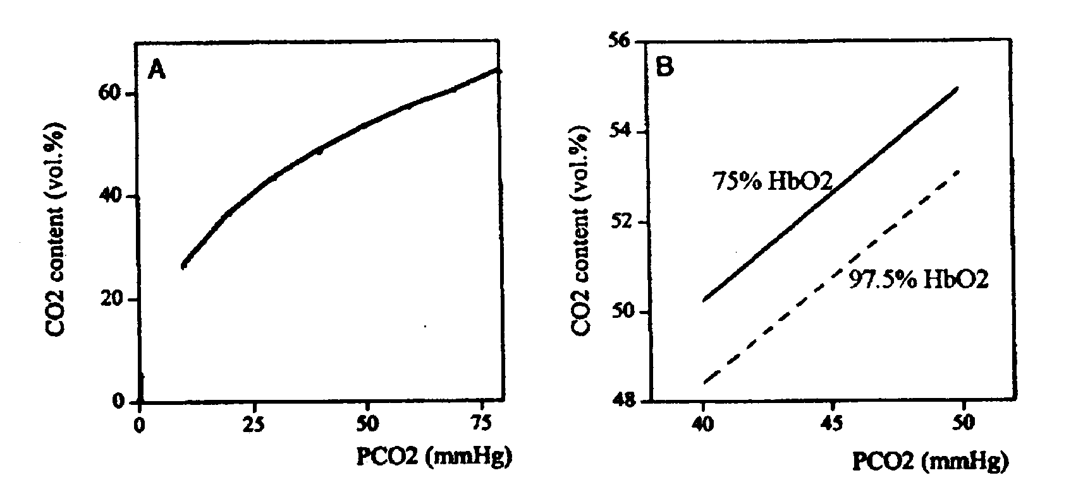
The Haldane Effect
•The O2 saturation of blood influences the CO2 dissociation curve by shifting it to the right.
The Haldane effect is the fact that mixed venous blood can carry more CO2 than can arterial blood.

Slide 24
Unlike the HbO2 curve, the CO2 dissociation curve has no steep or flat portions; the relationship between CO2 content and PCO2 is almost linear. This means that if we hypoventilate and alveolar PCO2 rises, then arterial, capillary, tissue and venous CO2 also rise. Doubling alveolar ventilation halves alveolar PCO2; it therefore follows that an increase in alveolar ventilation proportionally increases CO2 removal.

Slide 25
Tutorials:
March 29th, 5:30-6:30PM, McIntyre Palmer Howard 522 April 19th, 5:30-6:30pm, McIntyre 521

Slide 26
Lecture 5

Slide 27
H. Respiratory Failure
Respiratory failure occurs when the respiratory system is unable to do its job properly, due to failure of:
the gas exchanging capabilities of the lungs;
the neural control of ventilation (i.e. the drive to breathe);
the neuromuscular breathing apparatus (i.e. the respiratory muscles and their innervation).

Slide 28
I. Arterial Hypoxia (Hypoxemia)
Blood hypoxia: deficient blood oxygenation, i.e. low PaO2 and low % Hb saturation.
5 general causes of hypoxia:
Inhalation of low PO2 (e.g. at high altitude).
Hypoventilation: It means that alveolar ventilation in relation to the metabolic CO2 production is reduced. PaO2 decreases and PaCO2 increases.
Ventilation/perfusion imbalance in the lungs
Shunts of blood across the lungs: venous blood bypasses the gas exchanging region of the lungs and returns to the systemic circulation deoxygenated.
O2 diffusion impairment (e.g. thickening of the alveolar-capillary membrane, or pulmonary edema).

Slide 29
VI Control of Breathing
A.Voluntary vs Automatic Breathing
Breathing is under both voluntary and involuntary control.
•The central nervous system controls gas exchange by integrating all the information coming from the periphery which in turn, gives an adequate depth and frequency of breathing.
•There are separate neurological structures for automatic and voluntary control but the two systems interact:
  Cerebral hemispheres control voluntary breathing;
  Brainstem (pons and medulla) controls involuntary breathing.

Slide 30
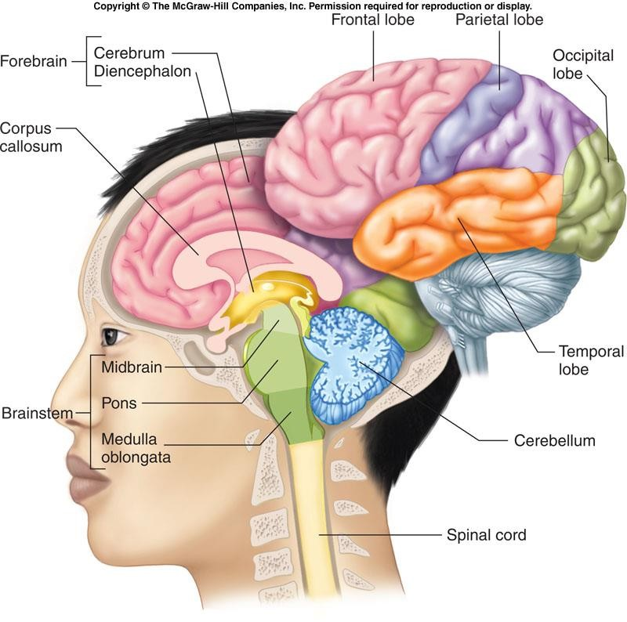
Voluntary vs Automatic Breathing

Slide 31
Voluntary vs Automatic Breathing
Breaking point:
If you stop ventilation voluntarily, you will find that in spite of your efforts to prevent it, breathing will eventually start again. This occurs because the arterial PCO2 has reached about 50 mm Hg and arterial PO2 has reached about 70 mm Hg, at which point voluntary control is over-ridden. This is called the breaking point. The over-riding of the voluntary control by the automatic control depends upon the information from the receptors sensitive to CO2 and O2 levels (in arterial blood and/or cerebro-spinal fluid).

Slide 32
B. Structures Involved in the Control of Breathing
There are 3 basic elements in the respiratory control system:
1) sensors: gather information about lung volume (pulmonary receptors)
and O2 and CO2 content (chemoreceptors);
controllers: information from the sensors is sent to the controller, in the pons and medulla, via afferent neural fibers. This peripheral information and inputs from the higher structures of the central nervous system are integrated;
effectors: neuronal impulses are then generated and sent via spinal motoneurons to the effectors, the respiratory muscles.

Slide 33
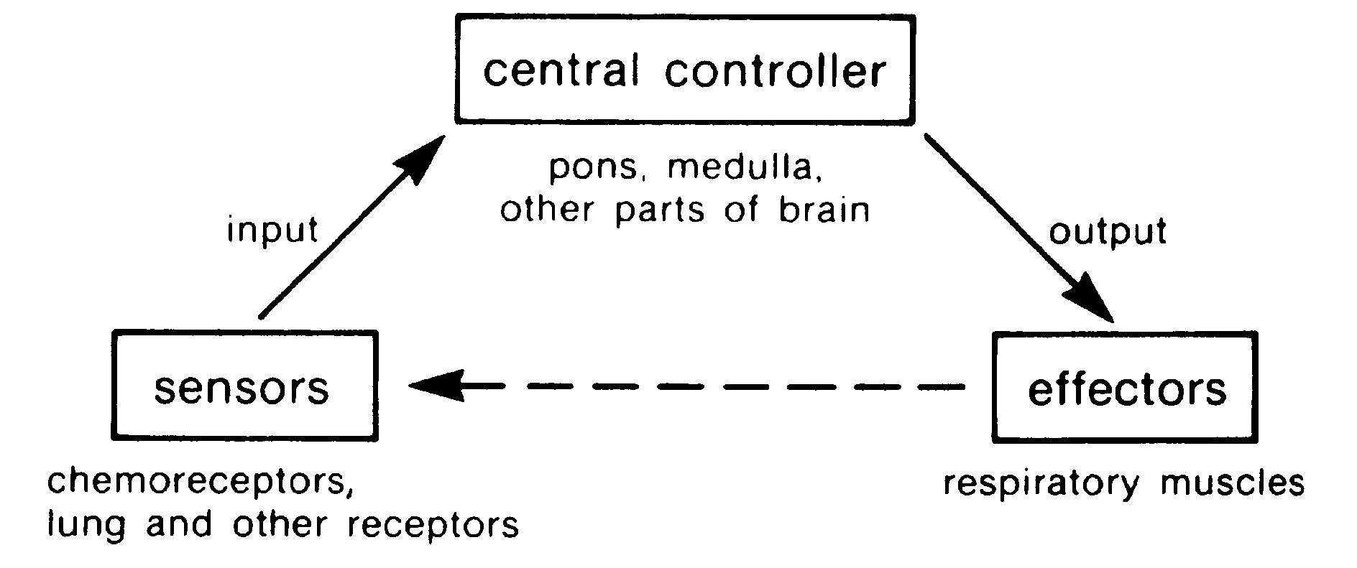
Structures Involved in the Control of Breathing

Slide 34
Voluntary vs Automatic Breathing

Slide 35
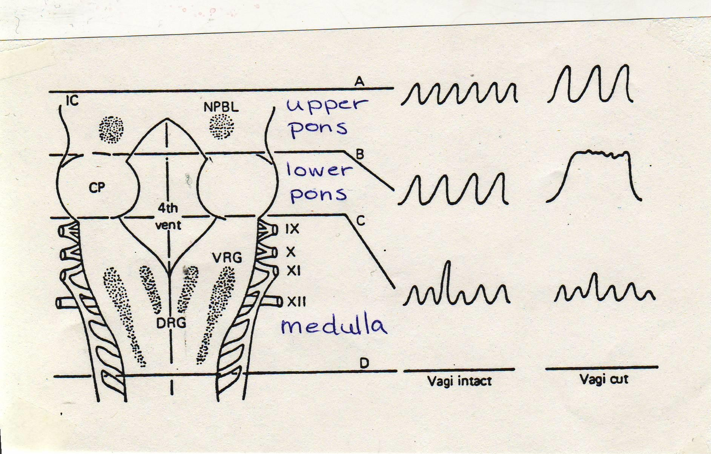

Slide 36

C. Respiratory Neurons
Pattern of breathing Medulla:
Medulla: - Contains pacemaker cells.
-Mainly located into 2 groups :
.ventral respiratory group that generates the basic rhythm,
.dorsal respiratory group that receives several
sensory inputs.
-The ventral and dorsal groups also connect to each other.
∴Respiratory neurons in the medulla generate the basic respiratory rhythmicity.

Slide 37
Rhythm

Slide 38
C. Respiratory Neurons
Pattern of breathing Pons (upper):
-Cells located in the rostral ( upper) pons “turn-off” inspiration.
-This leads to smaller tidal volume and increased breathing
frequency.
∴ Cutting the pneumotaxic centers causes breathing to become deep and slow.
(This is the same effect as cutting the vagus nerves which
bring afferent information).

Slide 39
Turn-off inspiration

Slide 40
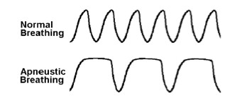
C. Respiratory Neurons
Pattern of breathing
∴Removing influence of both the upper pons and the vagus nerves causes apneuses (tonic inspiratory activity interrupted by short expirations). This type of breathing is seen in some severe types of brain injury.

Slide 41
C. Respiratory Neurons
Pattern of breathing
Pons (lower):
Cells located in the lower pons (called the apneustic center) send excitatory impulses to the respiratory groups of the medulla, thus promoting inspiration.

Slide 42
Promote inspiration

Slide 43
Turn-off inspiration
Promote inspiration
Rhythm

Slide 44
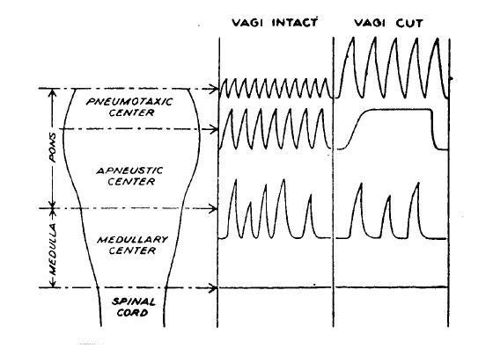
From the web…

Slide 45
D. Chemoreceptors
•PO2, PCO2, and pH in arterial blood are detected by chemoreceptors.
If these pressures (or pH) Δ → ventilation Δ
Information from the chemoreceptors is carried to the respiratory neurons.
•The activity of respiratory neurons will increase if
PaO2 is < 60 mm Hg or
PaCO2 > 40 mm Hg.
•The activity of the respiratory neurons will decrease if PaO2 > 100 mm Hg or
PaCO2 < 40 mm Hg.

Slide 46
There are 2 types of chemoreceptors:
Central and Peripheral

Slide 47
1) Central Chemoreceptors:
•Central chemoreceptors are located on the ventral surface of the medulla.
•They detect the pH of the cerebrospinal fluid (CSF) surrounding them (PCO2 and pH of the CSF are influenced by those of arterial blood).
•The central chemoreceptors give rise to the main drive to breathe under
normal conditions.

Slide 48
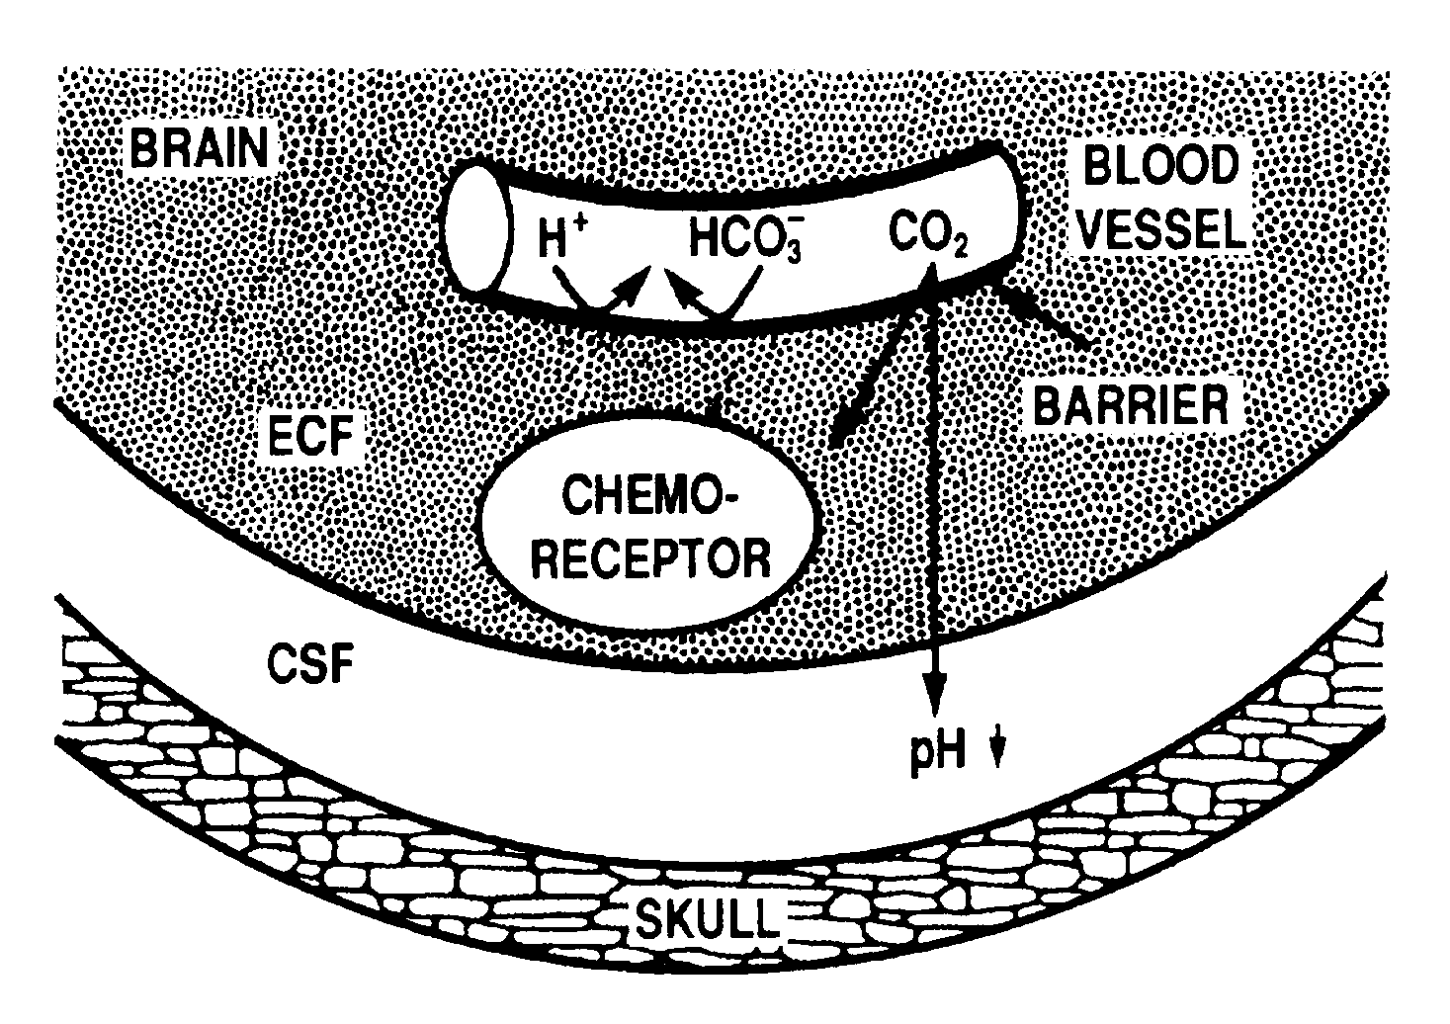
Central Chemoreceptors
Environment of the central chemoreceptors: they are bathed in brain extracellular fluid (ECF), through which CO2 easily diffuses from the blood vessels to cerebrospinal fluid (CSF). The CO2 reduces the CSF pH, thus stimulating the chemoreceptor. H⁺ and HCO3⁻ cannot easily cross the blood- brain barrier.
(Reproduced from West: Respiratory Physiology- the essentials)

Slide 49
Central Chemoreceptors
CO2 + H2O → H2CO3 (1)
H2CO3 → HCO3⁻ + H⁺ (2)
(Reproduced from West: Respiratory Physiology- the essentials)

Slide 50
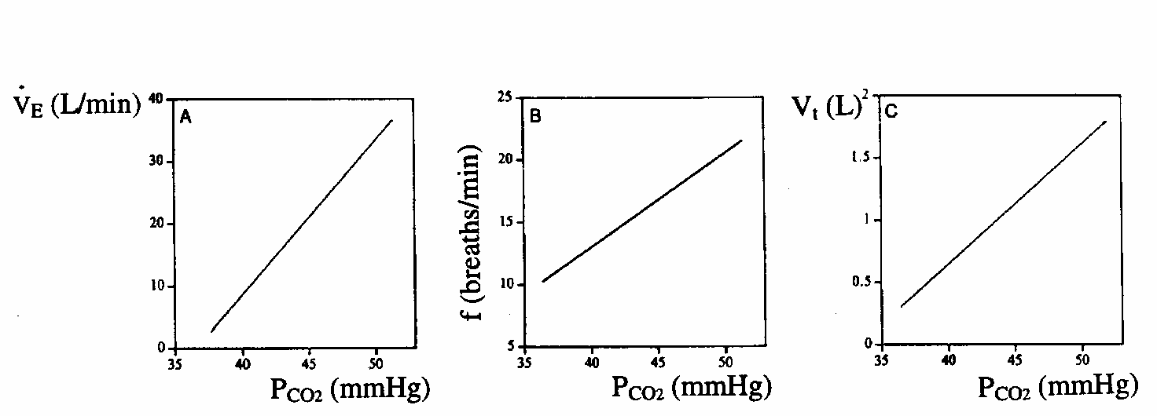
Ventilatory response to hypercapnia (elevated CO2 in blood):
The sensitivity of the central chemoreceptors can be assessed by performing a CO2 rebreathing test, i.e. breathe different CO2 mixtures, or rebreathe expired air from a bag filled with O2.

Slide 51
2) Peripheral Chemoreceptors:
•Peripheral chemoreceptors are mainly sensitive to changes in PO2, but are
also stimulated by increased PCO2 and decreased pH.
•They are located in the carotid bodies (i.e. the bifurcation of the common carotid arteries) and in the aortic bodies (next to the ascending aorta).

Slide 52
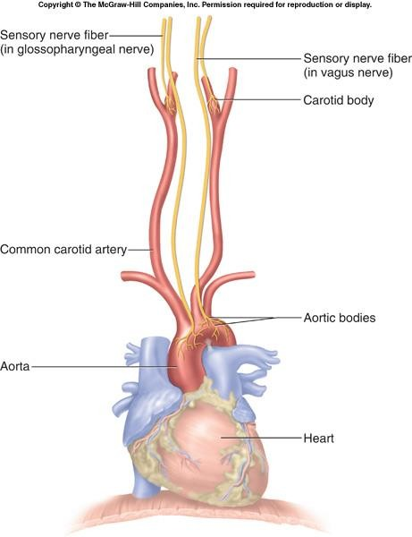
Figure 32. Peripheral chemoreceptors.

Slide 53
Peripheral Chemoreceptors:
The carotid and aortic bodies are made up of blood vessels, structural supporting tissue, and numerous nerve endings of sensory neurons of the glossopharyngeal (in carotid bodies, IX nerve) and vagus nerves (in aortic bodies, X nerve).
The afferent fibers of these receptors project to the dorsal group of respiratory neurons in the medulla.

Slide 54
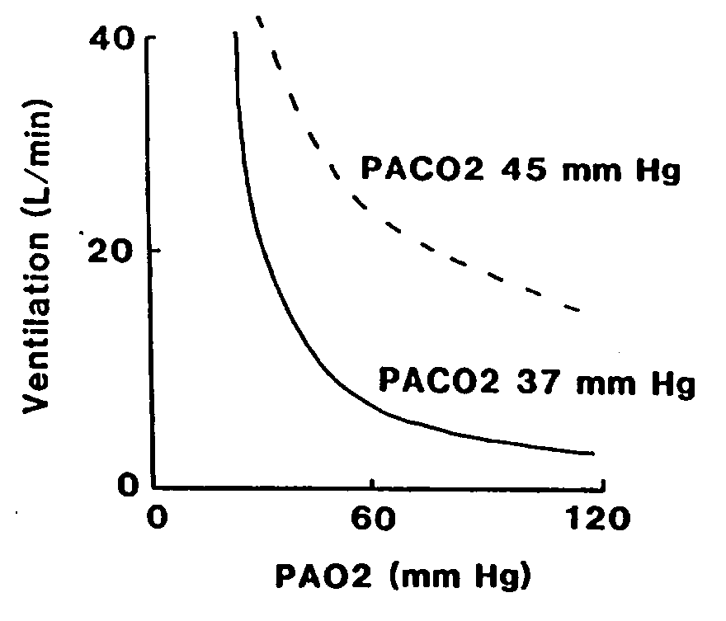
E. Ventilatory response to decreased PO2
•The effects of hypoxia on ventilation can be studied by having a subject breathe gas mixtures with decreased concentrations of O2.
•During normocapnia (normal levels of CO2 in blood), the alveolar PO2 can be reduced
to about 60 mm Hg before appreciable changes in minute ventilation occur.
•Increasing PCO2, increases ventilation at any PO2.

Slide 55
F. Pulmonary Vagal Receptors
There are 3 types of receptors in the lung that respond to mechanical stimuli:
Pulmonary Stretch Receptors;
Irritant Receptors;
Juxta-capillary or J receptors (C-fibres);
Afferent fibers from all of these receptors travel in the vagus nerves. If the vagus nerve is sectioned, the result is slow, deep breathing.

Slide 56
1) Pulmonary Stretch Receptors:
•Pulmonary stretch receptors are located in smooth muscles of the trachea down to the terminal bronchioles.
•They are innervated by large, myelinated fibres, and they discharge in response to distension of the lung.
•Their activity is sustained as long as the lung is distended.
•Activity of these receptors phasically increases as lung volume increases during each inspiration.

Slide 57
Pulmonary Stretch Receptors:
•The main reflex effect of stimulating the pulmonary stretch receptors is the Hering-Breuer Inflation Reflex.
•Hering-Breuer Inflation Reflex: is a decrease in respiratory frequency due to a prolongation of expiratory time.
•In other words, an increase in lung volume tends to inhibit the beginning of the next inspiratory effort (negative feedback mechanism).
•The Hering-Breuer reflex is weak in adults unless the tidal volume exceeds 1 L as in exercise, but is noticeable in infants and animals.

Slide 58
2) Irritant Receptors:
•The irritant receptors are located between airway epithelial cells in the
trachea down to the respiratory bronchioles.
•They are stimulated by noxious gases, cigarette smoke, histamine, cold air, and dust.
•They are innervated by myelinated fibers, and their stimulation leads to bronchoconstriction and hyperpnea (increased breathing deapth).
•The irritant receptors may be important in the reflex bronchoconstriction
triggered by histamine release during an allergic asthmatic attack.

Slide 59
3) Juxta-Capillary Receptors:
•The name of these fibres originates from their location in the alveolar walls close to the capillaries.
•They are innervated by non-myelinated fibres and have short lasting bursts of activity. They are stimulated by an increase in pulmonary interstitial fluid, like what may occur in pulmonary congestion and edema.
•The reflex effects caused by these receptors include rapid and shallow
respiration, although intense stimulation causes apnea.
•These receptors may play a role in dyspnea (sensation of difficulty in breathing) associated with left heart failure and lung edema or congestion.

